Slide 1



Group 60
Yi Xing, Declan, Darren, Elizabeth, Ying Zhen
Notes:
Eli introduce the website, very nice

Slide 2

Pain Points
Problem Statement
Information Overload
Generic Data
Travelers does not have the time and effort to sieve through all the hotel reviews
Notes:
ELI
For problem statement, we have 2 pain points, information overload and generic data.
Currently, there are too many information to read when researching for hotels on the internet, which will be tedious for the users.
Problem Statement
Pain points of users such as too many reviews and some some reviews not useful to them
Some lit review parts,
Reviews left by other guests are more valuable than marketing efforts from hotels

Slide 3


Solution
What does
Allows users to apply filters to filter only reviews relevant to them
Detailed Analysis
One stop application for users to get insights on hotels in Singapore
Notes:
ELI
We have a user friendly platform, EBW, which allows users to apply filters to filter only reviews relevant to them. It also have some analysis which shows the top 10 positive and negative words, and their reviews. This helps the users to decide which hotel suits them better.
Solution
Briefly talk about what EBW does
What it aim to solve

Slide 4



Target Audience
First time travellers who are visiting Singapore and is currently searching for accommodation.
Notes:
ELI
Our target audience is first time travellers who are visiting Singapore and is currently searching for accommodation.

Slide 5
Stage 1
Data Crawling For Links
Stage 2
Data Scraping
Stage 3
Stages of project
Data Cleaning/Pre-processing
Stage 4
Data Analytics
Stage 5
Implementation Of Website
Notes:
YX
These are the 5 stages of the project. From data scraping to the implementation of the website. We will be running through each stages in detail in the following slides

Slide 6

Data Scraping
Notes:
YX
Next, is Data Scraping.

Slide 7
Data Crawling + Data Scraping
1
2
3
Crawl for Hotel Links
Scrape link for general data
Scrape link for reviews data
Get all the links of hotels in Singapore
Extract general data from html elements
Extract review data from html elements
Notes:
YX
The data scraping process is split into 3 parts
Crawling for the hotel links
Followed by scraping the link to get data to populate the general data
Finally, scraping the link to get data for the reviews data

Slide 8
Data Preprocessing
Notes:
YZ
For data preprocessing there are 2 types of data, General and Review.

Slide 9
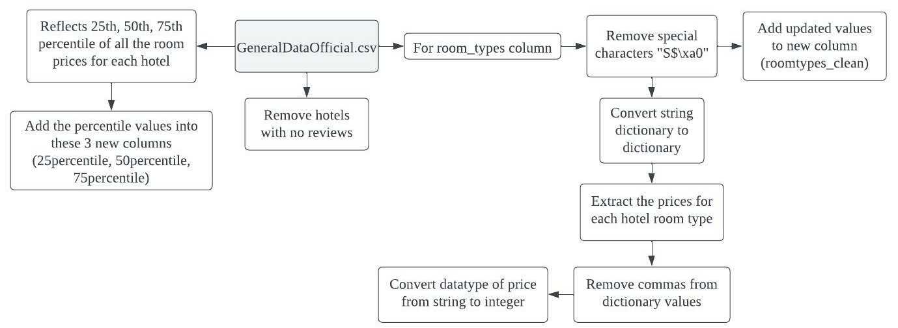
Data Preprocessing (General)
Notes:
YZ
In General data, for room_types column, we removed the special characters and convert from string dictionary to dictionary, to extract the prices for each hotel room type.
We removed hotels with no reviews, as they are not useful for analysis.
We added 3 columns “25percentile to “75percentile”, to reflect its percentile of all the room prices for each hotel.
Hotels removed Spacious and Lings, not useful valuable for analysis

Slide 10
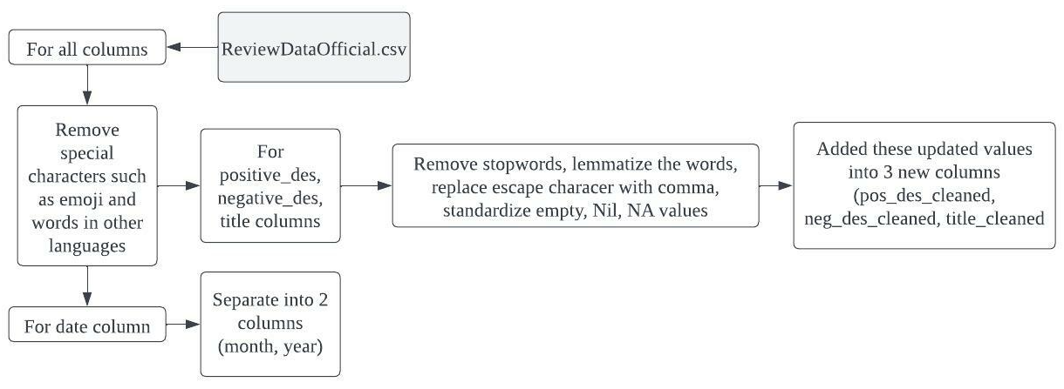
Data Preprocessing (Review)
Notes:
YZ
In Review data, we also removed special characters such as emoji and words in other languages for all columns.
For positive, negative and title columns, we remove the stopwords, lemmatize the words, replace escape character with comma and standardize all empty, Nil, NA values.
We separated the date column into 2 columns “month” and “year”.
More indepth abt how the cleaning is done

Slide 11
Data Analytics
Notes:
YX

Slide 12
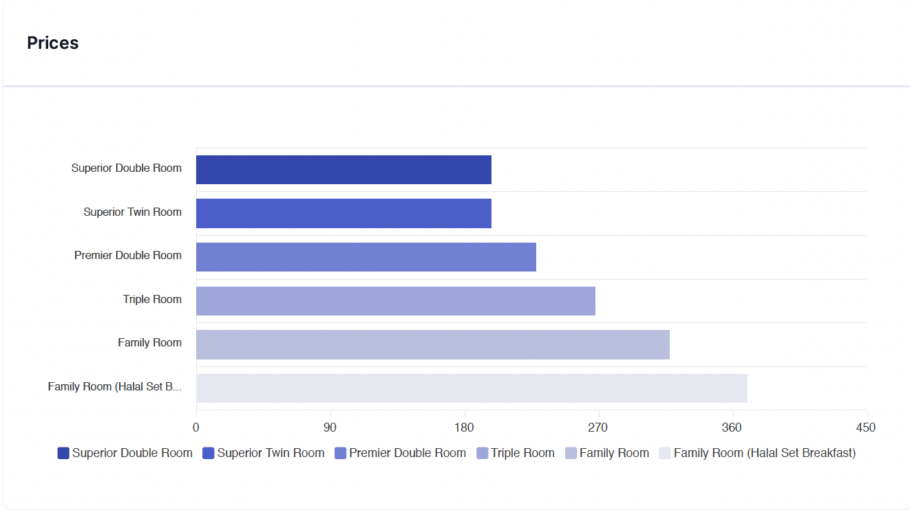

Room Price Analysis
Shows the different prices of the types of rooms the hotel provides
Notes:
YX
We did room price analysis to show the different prices of the types of rooms of a hotel

Slide 13
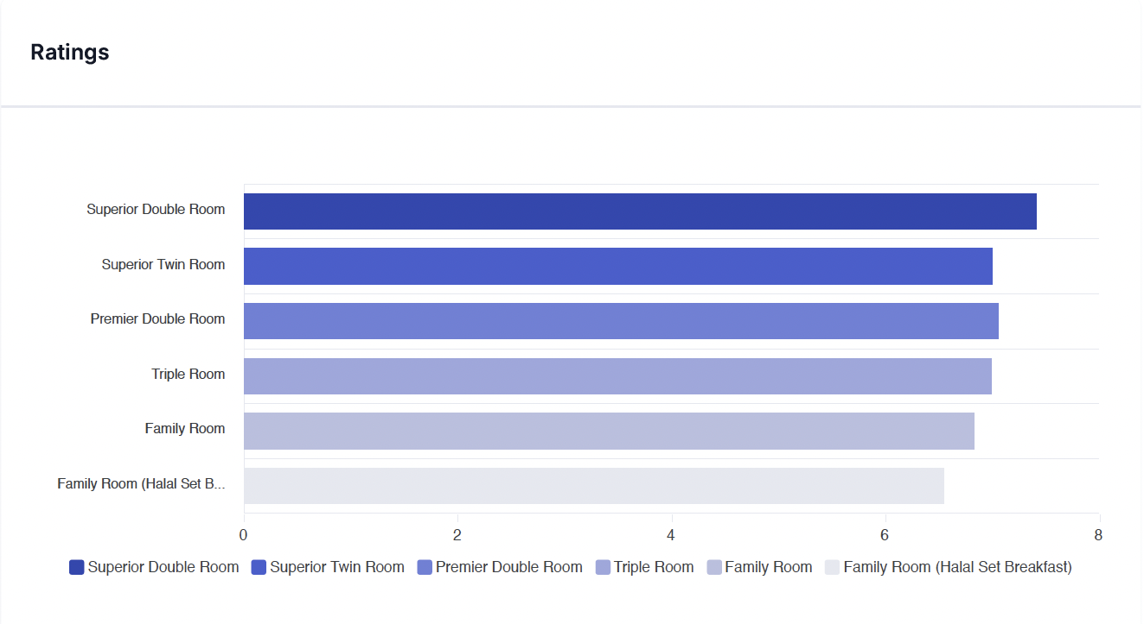
Room Ratings Analysis
Shows the average ratings of the types of rooms the hotel provides
Notes:
Then we found out the average ratings for each room

Slide 14
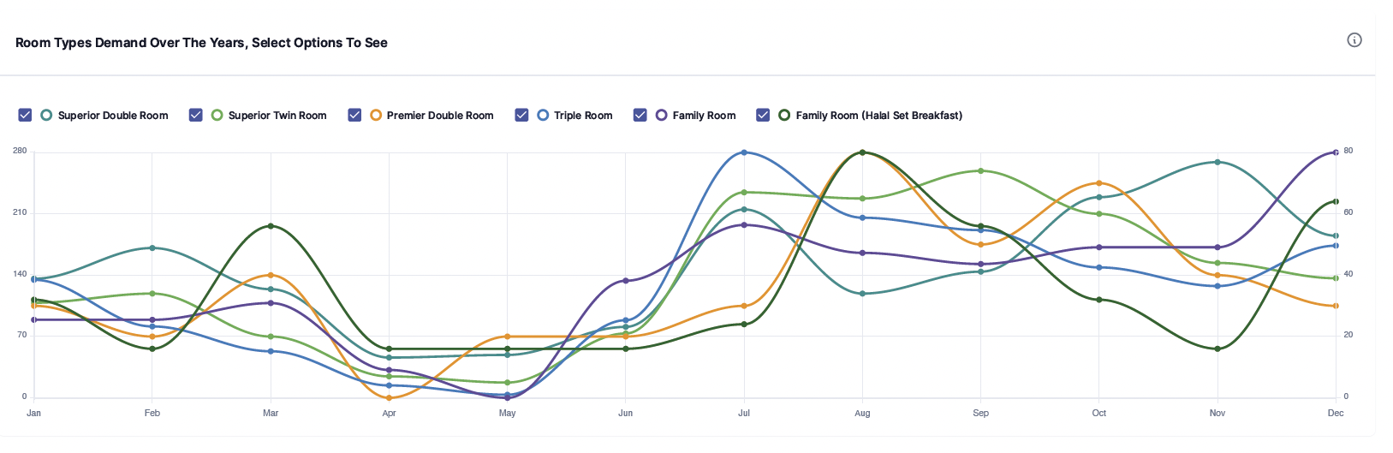
Shows the demand of different rooms over the months
Room Demand
Notes:
YX
We also analysed the demand of the room types by looking at the number of reviews provided

Slide 15
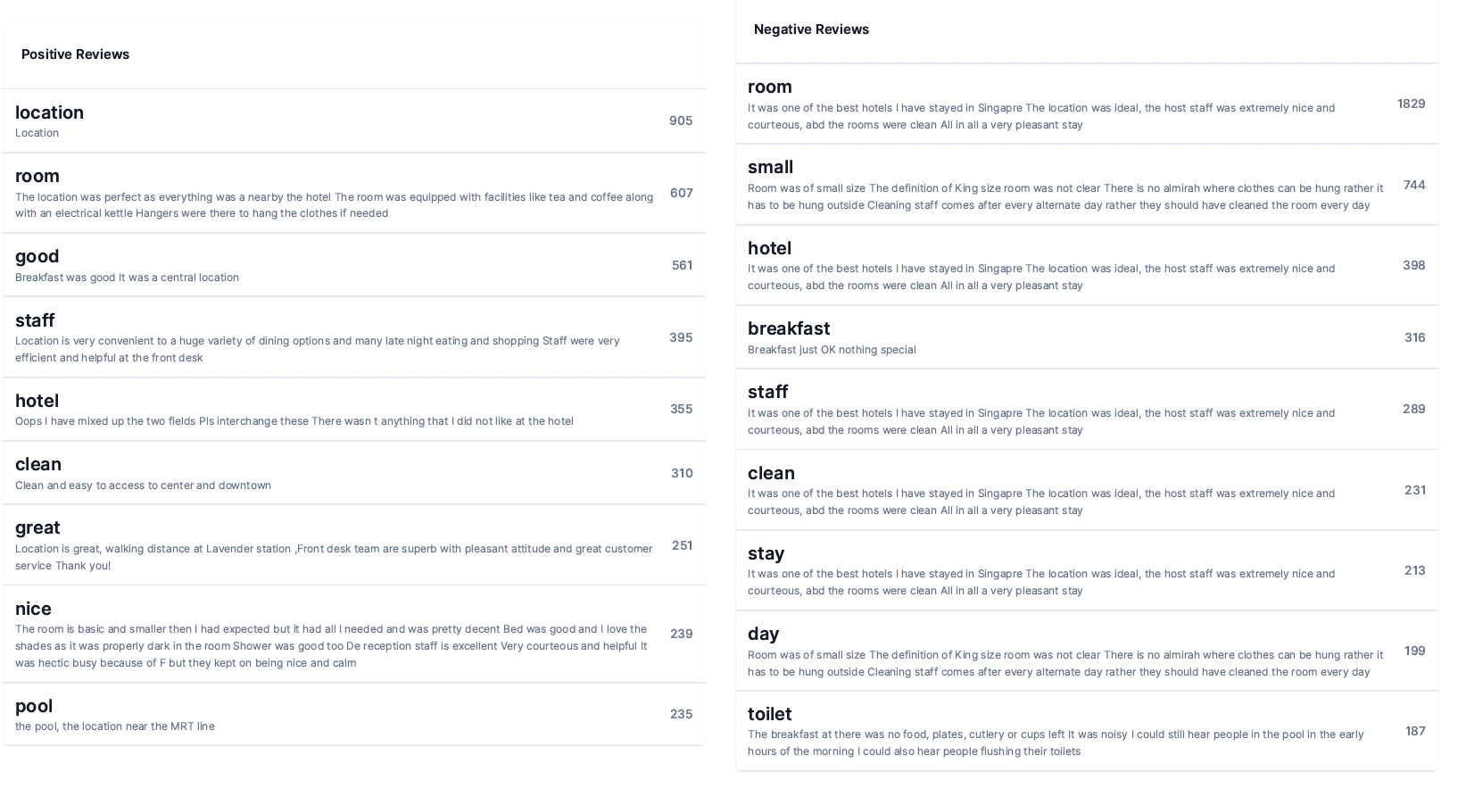
Text Analysis (Positive)
Shows the top 10 frequent words of positive reviews and 5 reviews containing the word
Notes:
YX
We looked at the top 10 words that appeared in positive reviews and also showed 5 reviews containing those words

Slide 16
Text Analysis (Negative)
Shows the top 10 frequent words of negative reviews and 5 reviews containing the word
Notes:
YX
We did the same for negative reviews

Slide 17
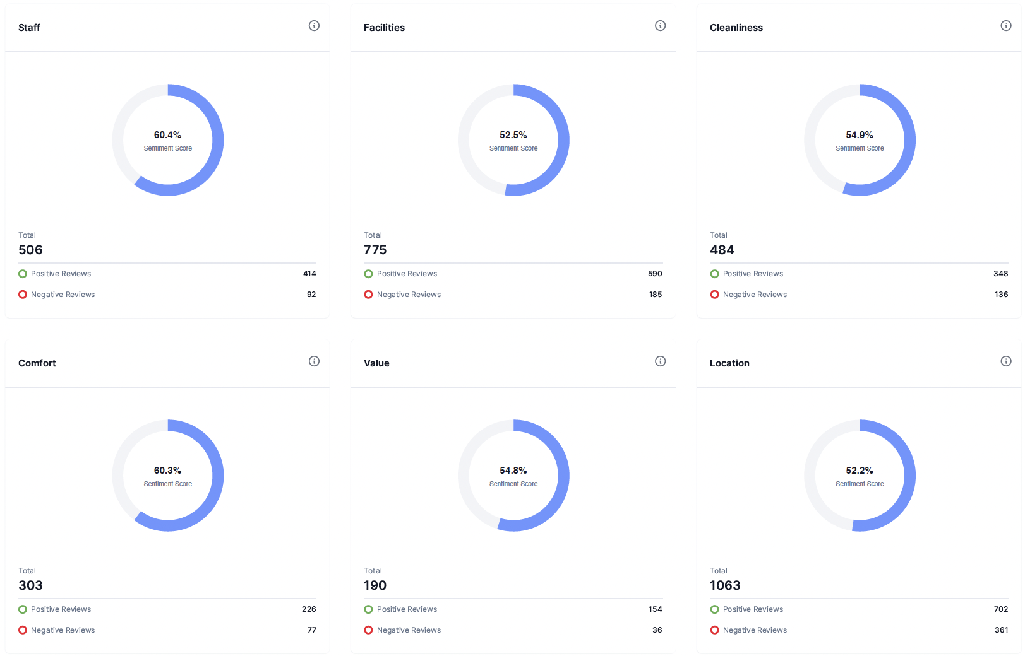
Sentiment Analysis
Overall sentiment score and number of positive and negative on the 6 categories of review
Notes:
We showed the sentiment scores of each categories of reviews and also displayed the number of positive and negative reviews for each categories

Slide 18
Implementation
Notes:
YX

Slide 19
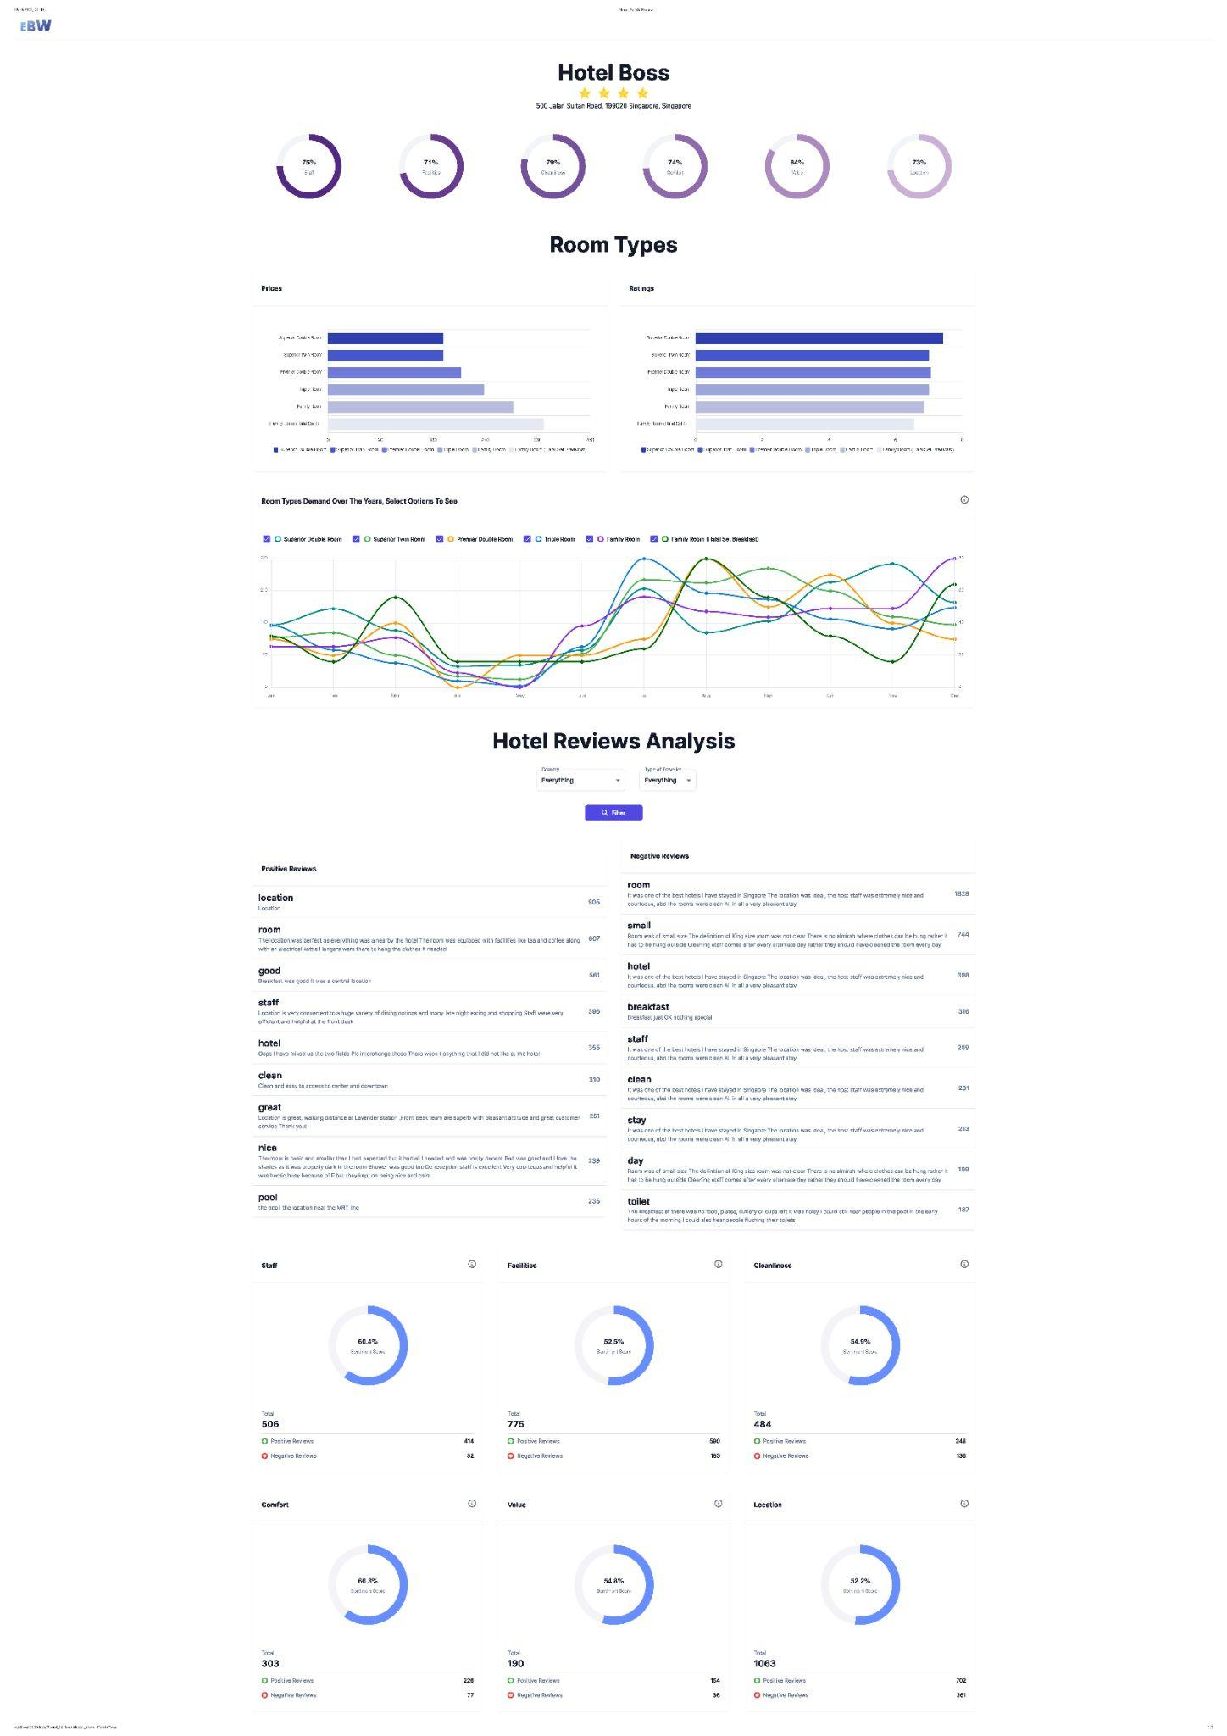



Search For Hotel
Website Picture here
Select Room Types Data
Filter for country and Type of traveler
Notes:
YX

Slide 20
Run through of website
Notes:
YX

Slide 21
Future Implementations
Notes:
Darren

Slide 22
Download Report of Hotel
Comparison feature
Be able download a copy of more detailed analysis of their hotel and get recommendations on how to improve
Allow users to compare between hotels side by side
Classifier and Sentiment Analysis Improvements
Live Data
Automate scraping process in the website’s backend in order to extract live data from booking.com
Improve the classifier algorithm and also replacing VADER with RoBERTa which is better model
Notes:
Darren
Under future implementations our Data Scraper can be improved by
Automating the website backend scraping process for live data extraction on booking.com, while applying threading methods for efficiency.
We could also utilize rotating proxies to prevent the web-server from blocking IP addresses.
The Data Analytics segment can be
improved via the classifier by utilizing NLTK to add synonyms for relevant words in the CSV file.
Replacing the VADER model with the RoBERTa model which is far more accurate and consistent when it comes to recognizing relationships between words. As a deep learning model RoBERTa is more inclined to recognize text based sarcasm and also understand memes like a human. Therefore this model would churn out far more reliable results and provide quality insights to guest reviews.
Lastly for our Website we could
Include a “Download Report of Hotel” feature to grant hotel management with vital insights to their establishments.
We can also include error handling to target bugs that may arise from the website by implementing a comparison feature where users are able to compare hotels in parallel.

Slide 23




Thank You

